Slide 1


Slide 2

Databases aren’t a good store these days Robert Koch Big Data & Cloud Architect S&P Global Denver Dev Day October 19, 2018

Slide 3














Don’t throw away your database servers, there is still a home for it!

Slide 4
Here’s what we know
Customers are demanding more, quicker
Ability to scale up without more CPU
Moving to cloud solutions (serverless)
Agile movement has a second wind
We’re tracking more information than ever

Slide 5
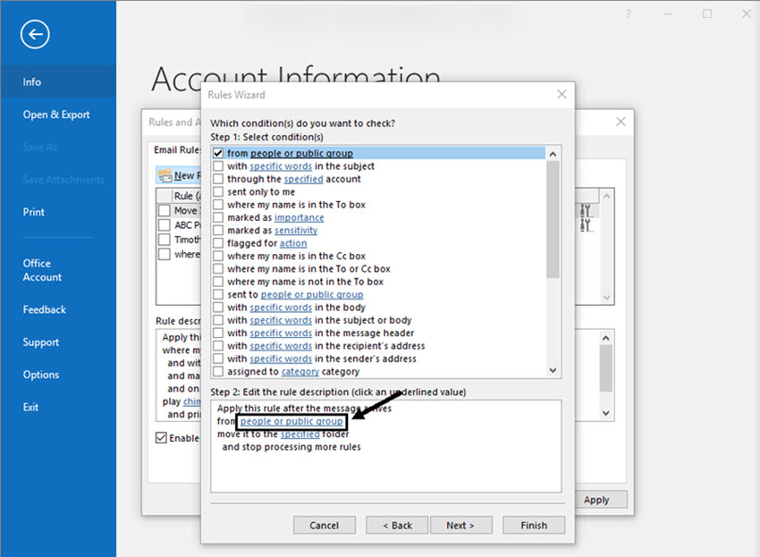
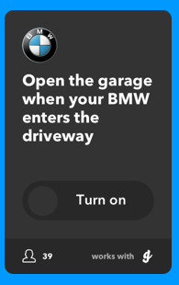
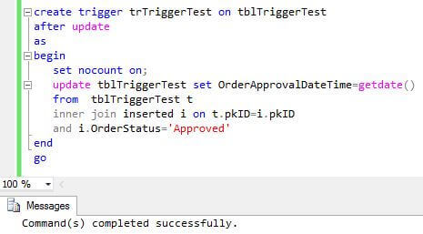
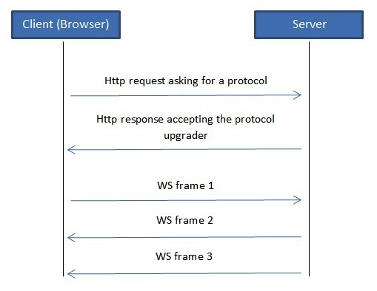
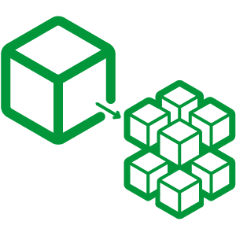
Examples of event-driven activities
Notes:
Because of increasing volume of data we’re capable of collecting, we need to migrate more to event driven architecture, but this is just to give you a taste of what is being event-driven is.

Slide 6

Adding value to ingestion Working our way back from the customer

Slide 7
CUSTOMER

Slide 8
Raw data
Top-notch analysis
Accurate
Easy to ingest
Timely
And… they want all this stuff as FAST as possible!
Forecasts
Aggregated
data

Slide 9

Adding technical values Helping the process along

Slide 10
Speed
More asynchronous actions
Less CPU
Flexibility
Legacy systems
Microservices
Accessibility
FTP
REST/GraphQL
PowerBI/Excel
Scrapeable web pages

Slide 11
What should we add?
Message Queuing Bus (centerpiece)
Business Process Management (workflow glue)
Microservices (simple-complex)
Serverless architecture (FaaS)

Slide 12

Adding business values Connecting business with customers

Slide 13
Business value we can add
Fit customers needs better
Sell more products
More upsell opportunities
Increase product portfolios
Ability to raise prices for incremental features
Better support capabilities

Slide 14

So what do we do?
Data
Data
FAST!
HOW?
Point A
Point B
Your favorite database
No, polling your database more often doesn’t work.
Notes:
Figure out how to get data from point A to point B as fast as possible
No, polling your database more often doesn’t work.
Think event-chaining
Whatever happens, something else *must* happen
Don’t leave the process stranded, do something with it
Current example in use: writing to table, then full stop; then some other process polls the database for the new data – very inefficient and loses precious minutes or seconds.
Better example: writing to table, communicate downstream new data is ready, new data ingested & processed, then communicated to the following system(s) whomever needs the data.
Availability & notification flow

Slide 15

Now let’s talk events Discuss best approaches

Slide 16

Direction
Think event-chaining
Notes:
Looks like something from Hellraiser, right??
Figure out how to get data from point A to point B as fast as possible
No, polling your database more often doesn’t work.
Think event-chaining
Whatever happens, something else *must* happen
Don’t leave the process stranded, do something with it
Current example in use: writing to table, then full stop; then some other process polls the database for the new data – very inefficient and loses precious minutes or seconds.
Better example: writing to table, communicate downstream new data is ready, new data ingested & processed, then communicated to the following system(s) whomever needs the data.
Availability & notification flow

Slide 17

Philosophy
Whatever happens, something else *must* happen!
Don’t leave the process stranded; do something with it.
Current example in use: writing to table, then full stop; then some other process polls the database for the new data – very inefficient and loses precious minutes or seconds.
Better example: writing to table, communicate downstream new data is ready, new data ingested & processed, then communicated to the following system(s) whomever needs the data.
Notes:
Think event-chaining
Whatever happens, something else *must* happen
Don’t leave the process stranded, do something with it
Current example in use: writing to table, then full stop; then some other process polls the database for the new data – very inefficient and loses precious minutes or seconds.
Better example: writing to table, communicate downstream new data is ready, new data ingested & processed, then communicated to the following system(s) whomever needs the data.
Availability & notification flow

Slide 18




The high-level picture
Availability & notification always happens.
Collect
Normalize
Model
New Service
kafka
µservice
Historical data
µservice
Dashboard
µservice
µservice
µservice
Notes:
Availability & notification flow
Go in deep about the systems interacting with one another
Orchestration

Slide 19

Time to get obsessed with events Into the details

Slide 20

Strategy: update in pieces
Web
Acme Widgets Webpage
ID | Name | Amount
1 | Alice | $4
2 | Bob | $3
3 | Carol | $5
4 | David | $4
5 | Ellie | $3
6 | Frank | $1
Bob
+ $2
ID | Name | Amount
1 | Alice | $4
2 | Bob | $3
3 | Carol | $5
4 | David | $4
5 | Ellie | $3
6 | Frank | $1
real-time update
2 Bob $5
kafka
Historical data
real-time notification
Notes:
How does updates happen in real-time and broadcasted?

Slide 21
Why is being event-driven faster?
You only update what’s necessary, not updating everything.
That makes development around message bus integrated with Agile better.
AWS EC2 & Azure VMs are most expensive pieces of the cloud
Storage is expensive, CPU cycles are expensive too
Find ways to alleviate those costs
Low CPU message bus
Putting a message bus in front of any microservice usually would makes it scale better without needing load balancer, which lessen complicated architecture. (I’ll show you…)
Discoverable
simplify, Simplify, SIMPLIFY
Notes:
We are more prevalent in the cloud, CPU cycles are important
Discoverable instead of being buried in the database.
Simplify the architecture

Slide 22


How µservices are better with an ESB
From outside
Fast Service
Slow Service
From inside
From outside
kafka
From inside
Fast Service
Slow Service

Slide 23
Use cases for a message bus
Build the fastest reporting platform in the world
Analyze on the fly as soon data comes in
Machine Learning plugged
Fast alerts if something not quite right with the data
Sports scores alert broadcast to services
Broadcast announcement of service status
Feeds web sockets, updates web page

Slide 24

Wrapping up Back to work!

Slide 25
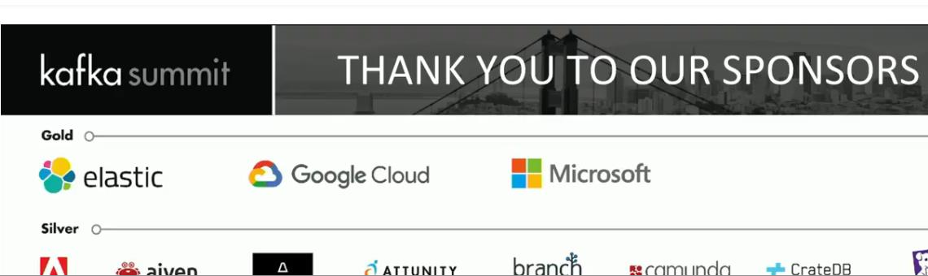
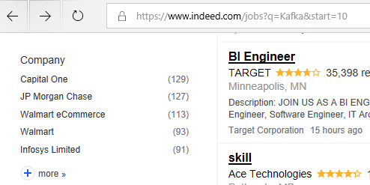
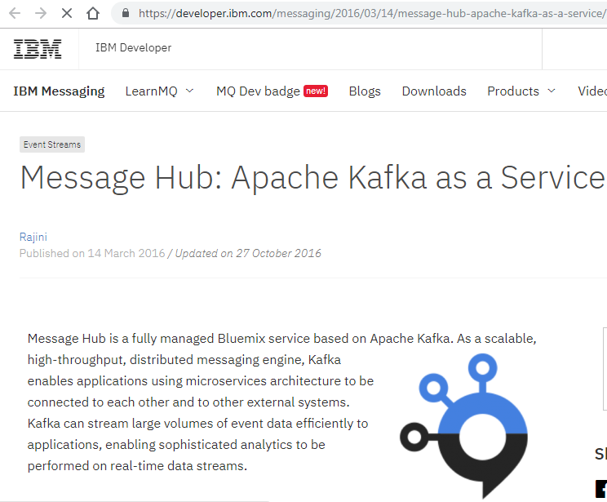
Check this out
Kafka Summit this week – who are the gold sponsors?
Indeed.com job board
What is IBM doing?

Slide 26
Reference
Gary Samuelson, Event-Based Business Architecture: Orchestrating Enterprise Communications, Kafka Summit SF 2018
Jennifer Riggins, Effective Microservices Architecture with Event-Driven Design, https://thenewstack.io/event-driven-design-will-drive-microservices-clarity/
Martin Kleppman, Keynote Day 2, Kafka Summit SF 2018 https://www.youtube.com/watch?v=v2RJQELoM6Y
Microsoft, Shell invests in safety with Azure, AI, and machine vision to better protect customers and service champions, http://customers.microsoft.com/en-us/story/shell-mining-oil-gas-azure-databricks
Ben Stopford, Event Driven 2.0, https://www.confluent.io/blog/event-driven-2-0
And of course any talks/blogs by Neha Narkhede, CTO, Confluent and Jay Kreps, CEO, Confluent.

Slide 27
Contact
Email: rob.koch@live.com
Twitter: @robcube
Github: http://github.com/robcube
Blog: https://robcube.github.io
** You may find me at the nearest whiteboard **

